Slide 1


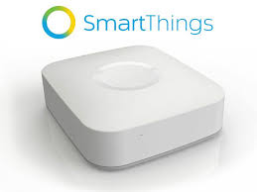
Auto creates child devices based on updates from Arduino.
Provides single file for end-user editing to define which devices and pins will be used.
Arduino Sketch
ST_Anything Parent Device
ST_Anything
Library
ST_Anything Child Devices
Implements ST Capabilities as Arduino sensors and actuators. Also, handles polling and updates.
Updates
Hub v2
Updates
SmartThings
Library
Based on original ThingShield Arduino library, now supports LAN connections as well as Zigbee ST ThingShield.
SmartApps
(SHM, CoRE, etc…)

Slide 2


Provides single file for end-user editing to define which devices and pins will be used.
Arduino Sketch
HubDuino Bridge Device
Auto creates child devices based on updates from Arduino.
HubDuino Service Manager App
Implements ST Capabilities as Arduino sensors and actuators. Also, handles polling and updates.
ST_Anything
Library
Button & RSSI Events
Hubitat Elevation Hub
ST_Anything Child Devices
SmartThings
Library
Based on original ThingShield Arduino library, now supports LAN connections as well as Zigbee ST ThingShield.
Events
Apps
(Rule Machine, Simple Lighting, etc…)

